Slide 1
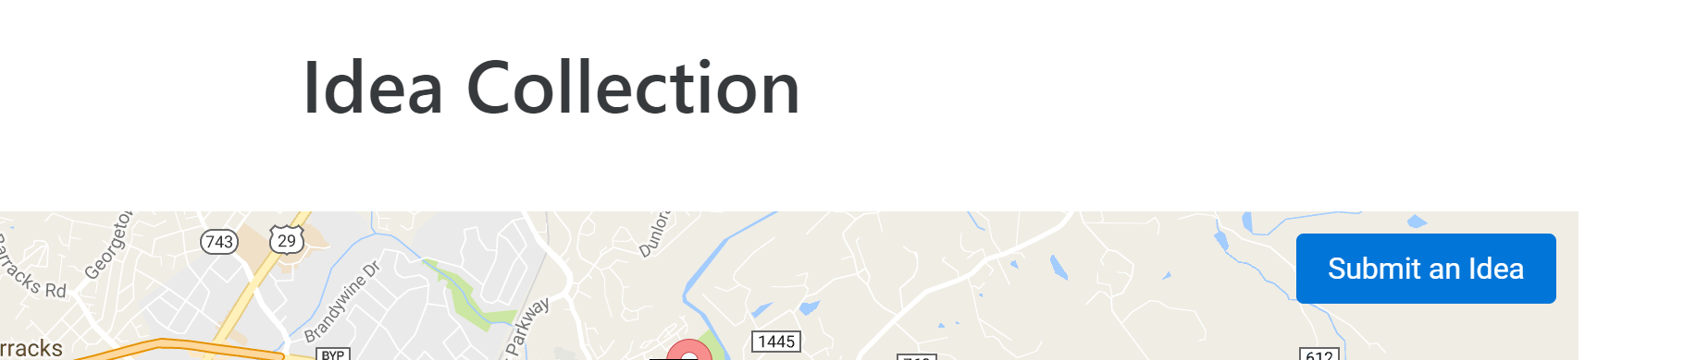
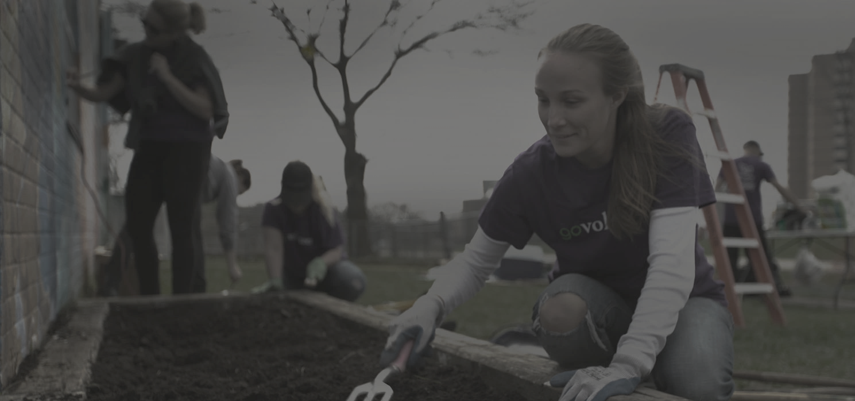


PAUSELAB – BECVILLE
COMMUNITY DRIVEN PROJECTS, COMMUNITY DRIVEN BUDGETING
Pauselab is a Charlottesville-based nonprofit that looks to facilitate civic engagement in the community. For their BeCville initiative, they were awarded a $15,000 grant to use on community projects. Rather than just initiate the projects on their own, they have decided to look toward the community for ideas. Therefore, they have employed a system called participatory budgeting where the residents themselves pitch ideas for projects and then also vote on these ideas to select a number to fund and actually carry out.
KEEPS THE COMMUNITY INVOLVED THROUGHOUT THE PROCESS
The system serves three primary purposes: collection and exposition of ideas, compilation of proposals to and from the community, and facilitation of community input on which ideas will receive funding.

